Slide 1


Lecture 14
Produced by Dr. Worldwide
Welcome to the 305
~
~

Slide 2


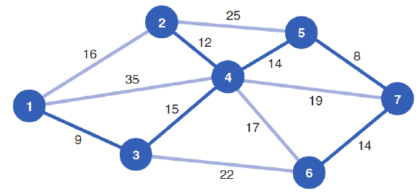
Ex: Cable Company
Recall the solution the minimal spanning tree problem for the cable example
Length of the minimal spanning tree is the sum of lengths of chosen edges
$$9+15+12+14+8+14=72$$

Slide 3
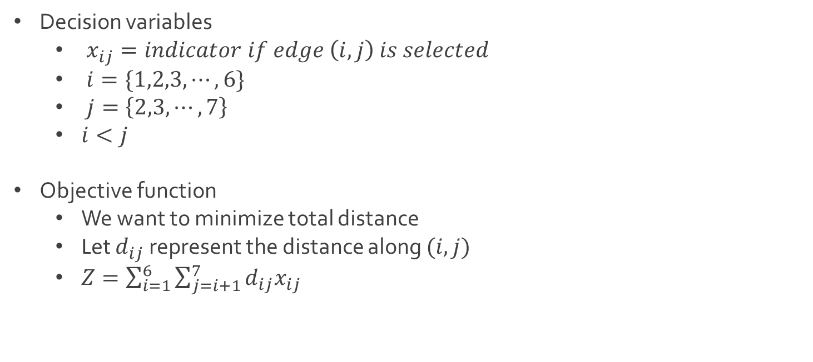
Ex: Cable Company
Decision variables
$x_{ij}=indicator if edge \left(i,j\right) is selected$
$i=\{1,2,3,⋯, 6\}$
$j=\left\{2,3,⋯,7\right\}$
$i<j$
Objective function
We want to minimize total distance
Let $d_{ij}$ represent the distance along $(i,j)$
$Z=\sum_{i=1}^{6}{\sum_{j=i+1}^{7}{d_{ij}x_{ij}}}$

Slide 4
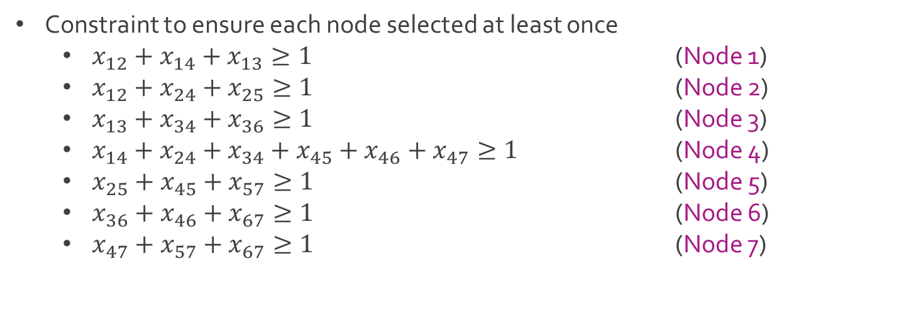
Ex: Cable Company
Constraint to ensure each node selected at least once
$x_{12}+x_{14}+x_{13}≥1$ (Node 1)
$x_{12}+x_{24}+x_{25}≥1$ (Node 2)
$x_{13}+x_{34}+x_{36}≥1$ (Node 3)
$x_{14}+x_{24}+x_{34}+x_{45}+x_{46}+x_{47}≥1$ (Node 4)
$x_{25}+x_{45}+x_{57}≥1$ (Node 5)
$x_{36}+x_{46}+x_{67}≥1$ (Node 6)
$x_{47}+x_{57}+x_{67}≥1$ (Node 7)

Slide 5
Ex: Cable Company
Observe the following pattern of spanning trees (possibly minimal)

Slide 6
Ex: Cable Company
Problematic cases that violate pattern
Case 1: Looping spanning tree
Case 2: Disconnected spanning trees

Slide 7
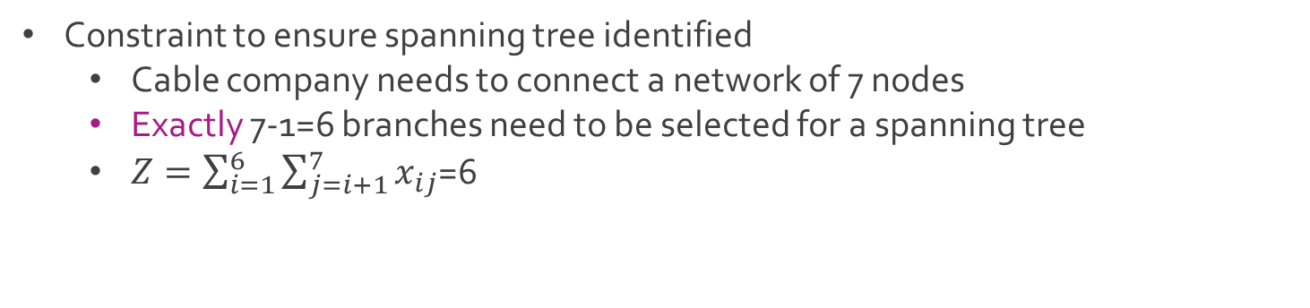
Ex: Cable Company
Constraint to ensure spanning tree identified
Cable company needs to connect a network of 7 nodes
Exactly 7-1=6 branches need to be selected for a spanning tree
$Z=\sum_{i=1}^{6}{\sum_{j=i+1}^{7}{x_{ij}}}$=6

Slide 8
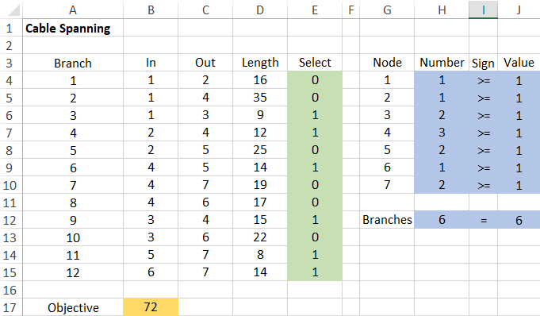
Ex: Cable Company
Download CableSpanning.xlsx from course website from link Sheet 1

Slide 9
Overview of Network Models
Three types of problems related to graphs with weighted edges
Shortest route
Maximal flow
Minimal spanning tree
All three problems had custom algorithms and linear programming formulations
Shortest route and minimal spanning tree are similar but give different solutions

Slide 10
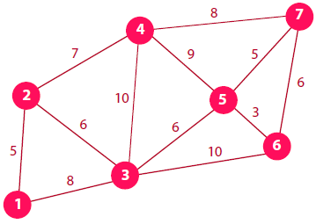
General Problem
Network of 7 nodes with undirected edges
Q: What is the shortest route from node 1 to all other nodes?
Q: What is the minimal spanning tree of the network?

Slide 11
General Problem
Shortest route algorithm
Start with permanent set {1}
Shortest adjacent node to node 1 is node 2 along edge (1,2)
Add node 2 to permanent set
Keep track of edge (1,2)
Set | Path | Distance
{1} | 1-2 | 5
 | 1-3 | 8

Slide 12
General Problem
Shortest route algorithm
New permanent set {1,2}
Shortest node to node 1, not in permanent set, is node 3
Add node 3 to permanent set
Keep track of edge (1,3)
Set | Path | Distance
{1} | 1-2 | 5
{1,2} | 1-3 | 8
 | 1-2-3 | 11
 | 1-2-4 | 12

Slide 13
General Problem
Shortest route algorithm
Set | Path | Distance
{1} | 1-2 | 5
{1,2} | 1-3 | 8
{1,2,3} | 1-2-4 | 12
 | 1-3-4 | 18
 | 1-3-5 | 14
 | 1-3-6 | 18

Slide 14
General Problem
Shortest route algorithm
Set | Path | Distance
{1} | 1-2 | 5
{1,2} | 1-3 | 8
{1,2,3} | 1-2-4 | 12
{1,2,3,4} | 1-2-4-5 | 21
 | 1-3-5 | 14
 | 1-3-6 | 18
 | 1-2-4-7 | 20

Slide 15
General Problem
Shortest route algorithm
Set | Path | Distance
{1} | 1-2 | 5
{1,2} | 1-3 | 8
{1,2,3} | 1-2-4 | 12
{1,2,3,4} | 1-3-5 | 14
{1,2,3,4,5} | 1-3-6 | 18
 | 1-3-5-6 | 17
 | 1-2-4-7 | 20
 | 1-3-5-7 | 19

Slide 16
General Problem
Shortest route algorithm
Set | Path | Distance
{1} | 1-2 | 5
{1,2} | 1-3 | 8
{1,2,3} | 1-2-4 | 12
{1,2,3,4} | 1-3-5 | 14
{1,2,3,4,5} | 1-3-5-6 | 17
{1,2,3,4,5,6} | 1-2-4-7 | 20
 | 1-3-5-6-7 | 23
 | 1-3-5-7 | 19

Slide 17

General Problem
Shortest route algorithm
The sum of all the edges from the final spanning tree
Closest | Path | Distance
2 | 1-2 | 5
3 | 1-3 | 8
4 | 1-2-4 | 12
5 | 1-3-5 | 14
6 | 1-3-5-6 | 17
7 | 1-3-5-7 | 19
$$5+7+8+6+3+5=34$$

Slide 18
General Problem
Minimal spanning tree algorithm
Start with node 1 in spanning set {1}
Shortest adjacent node to any node in spanning set is node 2
Add node 2 to spanning set
Keep track of edge (1,2)
Set | Path | Distance
{1} | 1-2 | 5
 | 1-3 | 8

Slide 19
General Problem
Minimal spanning tree algorithm
Consider spanning set {1,2}
Shortest adjacent node to any node in spanning set is node 3
Add node 3 to spanning set
Keep track of edge (2,3)
Set | Path | Distance
{1} | 1-2 | 5
{1,2} | 1-3 | 8
 | 2-3 | 6
 | 2-4 | 7

Slide 20
General Problem
Minimal spanning tree algorithm
Consider spanning set {1,2,3}
Shortest adjacent node to any node in spanning set is node 5
Add node 5 to spanning set
Keep track of edge (3-5)
Set | Path | Distance
{1} | 1-2 | 5
{1,2} | 2-3 | 6
{1,2,3} | 2-4 | 7
 | 3-4 | 10
 | 3-5 | 6
 | 3-6 | 10

Slide 21
General Problem
Minimal spanning tree algorithm
Set | Path | Distance
{1} | 1-2 | 5
{1,2} | 2-3 | 6
{1,2,3} | 3-5 | 6
{1,2,3,5} | 2-4 | 7
 | 3-4 | 10
 | 5-4 | 9
 | 3-6 | 10
 | 5-6 | 3

Slide 22
General Problem
Minimal spanning tree algorithm
Set | Path | Distance
{1} | 1-2 | 5
{1,2} | 2-3 | 6
{1,2,3} | 3-5 | 6
{1,2,3,5} | 5-6 | 3
{1,2,3,5,6} | 2-4 | 7
 | 3-4 | 10
 | 5-4 | 9
 | 5-7 | 5
 | 6-7 | 6

Slide 23
General Problem
Minimal spanning tree algorithm
Set | Path | Distance
{1} | 1-2 | 5
{1,2} | 2-3 | 6
{1,2,3} | 3-5 | 6
{1,2,3,5} | 5-6 | 3
{1,2,3,5,6} | 5-7 | 5
{1,2,3,5,6,7} | 2-4 | 7
 | 3-4 | 10
 | 5-4 | 9
 | 7-4 | 8

Slide 24

General Problem
Minimal spanning tree algorithm
The sum of all the edges from the minimal spanning tree
Added | Path | Distance
2 | 1-2 | 5
3 | 2-3 | 6
5 | 3-5 | 6
6 | 5-6 | 3
7 | 5-7 | 5
4 | 2-4 | 7
$$5+7+6+6+3+5=32$$

Slide 25
General Problem
Solution comparison
Different solutions because algorithms target different goals

Slide 26




The End
Dale

